Slide 1
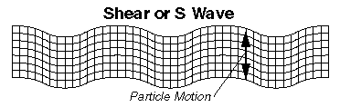
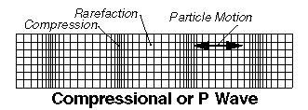
Pop Quiz – Wave Equation (ν = λf)
Earthquakes generate shock waves that travel through Earth’s interior to other parts of the world.
The fastest of these waves are longitudinal waves and are called primary waves, or just p-waves. A p-wave has a very low frequency, typically around 0.050 Hz. If the speed of a p-wave with this frequency is 8.0 km/s, what is its wavelength?
Earthquakes also produce transverse waves that move more slowly than the p-waves. These waves are called secondary waves, or s-waves. If the wavelength of an s-wave is 2.3 × 10⁴ m, and its speed is 4.5 km/s, what is its frequency?

Slide 2
Pop Quiz – Wave Equation (ν = λf)
The fastest of these waves are longitudinal waves and are called primary waves, or just p-waves. A p-wave has a very low frequency, typically around 0.050 Hz. If the speed of a p-wave with this frequency is 8.0 km/s, what is its wavelength?
Given: f = 0.050 Hz = 5.0x10⁻² Hz ν = 8.0 Km/s = 8.0x10³ m/s Required: Find wavelength λ Analysis: Use ν = λf Rearrange: λ = ν/f | Solution: λ = ν/f λ = 8.0x10³ / 5.0x10⁻² λ = 1.6x10⁵ Units = m, Sig Digits = 2 Paraphrase: The wavelength, λ, is 1.6x10⁵ m

Slide 3
Pop Quiz – Wave Equation (ν = λf)
Earthquakes also produce transverse waves that move more slowly than the p-waves. These waves are called secondary waves, or s-waves. If the wavelength of an s-wave is 2.3 × 10⁴ m, and its speed is 4.5 km/s, what is its frequency?
Given: λ = 2.3x10⁴ m ν = 4.5 Km/s = 4.5x10³ m/s Required: Find frequency f Analysis: Use ν = λf Rearrange: f = ν/λ | Solution: f = ν/λ f = 4.5x10³ / 2.3x10⁴ f = 0.1956 Units = Hz, Sig Digits = 2 Paraphrase: The frequency, f, is 2.0x10⁻¹ Hz

Slide 4
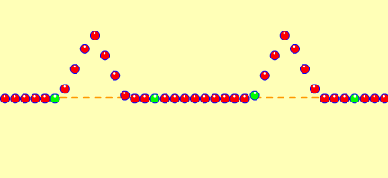
Superposition Of Pulses
What will happen when these two pulses meet at point “X”?
X

Slide 5
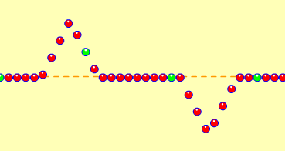
Superposition Of Pulses
What will happen when these two pulses meet at point “X”?
X

Slide 6
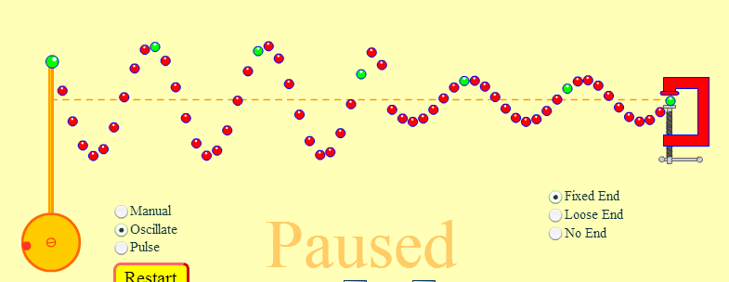

Interference of Waves
How was this pattern created?

